Slide 1
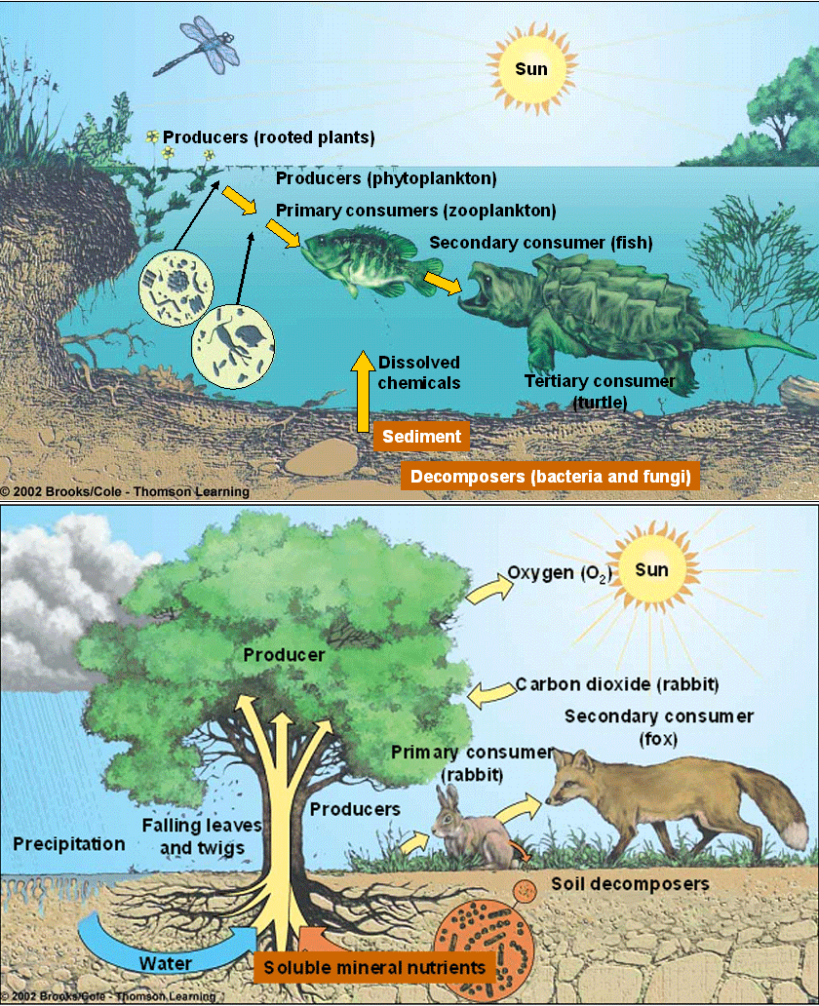
Ecosystems & Restoration Ecology

Slide 2
Learning Goals
Explain how thermodynamic laws govern ecosystems
Differentiate between how energy and chemicals move through ecosystems
Identify and explain the significance of trophic levels in ecosystems

Slide 3
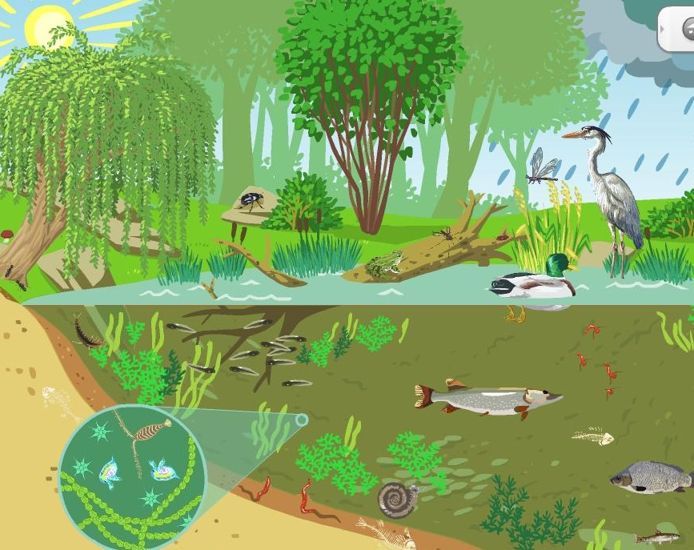
Introduction to Ecosystems
Ecosystem - the sum of all organisms in an area and the abiotic factors with which they interact

Slide 4
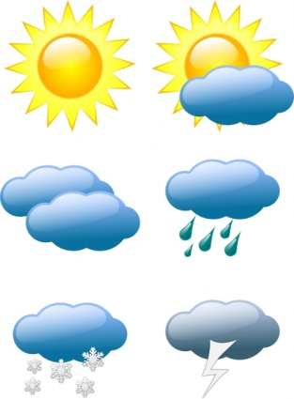

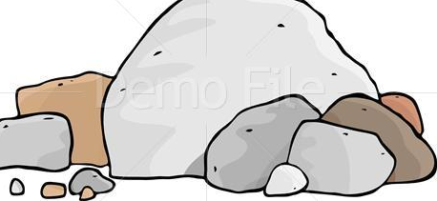
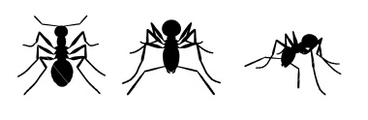
Ecosystem
Population
Individual
Community
Individual
Population

Slide 5
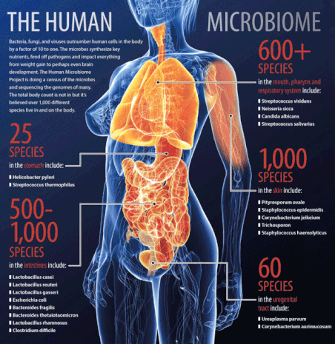
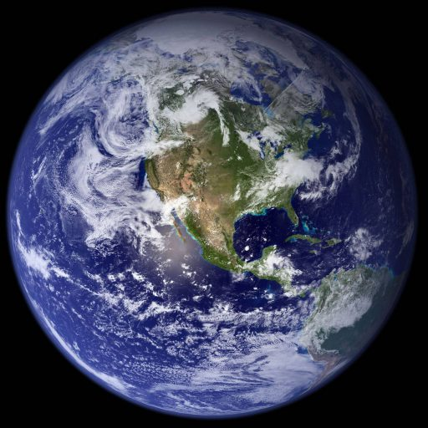
Ecosystem size
An ecosystem does not tell us anything about size or spatial extent (an ecosystem is not “bigger” or “smaller” than a community or habitat)
They can range in size from the very small (human microbiome) to the very large (biosphere)

Slide 6
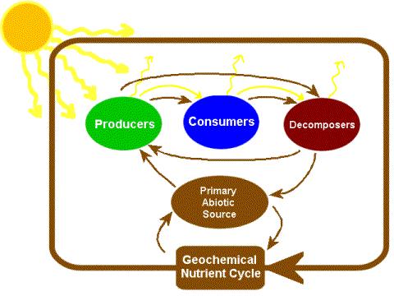
Key properties of ecosystems
Energy flow
Chemical cycling

Slide 7
Physical laws govern energy flow and chemical cycling
First law of thermodynamics - energy cannot be created or destroyed, but can only be transferred or transformed
Second law of thermodynamics - every exchange of energy increases the entropy of the universe
Law of the Conservation of Mass - in an isolated system, mass is neither created nor destroyed by chemical reactions or physical transformations

Slide 8
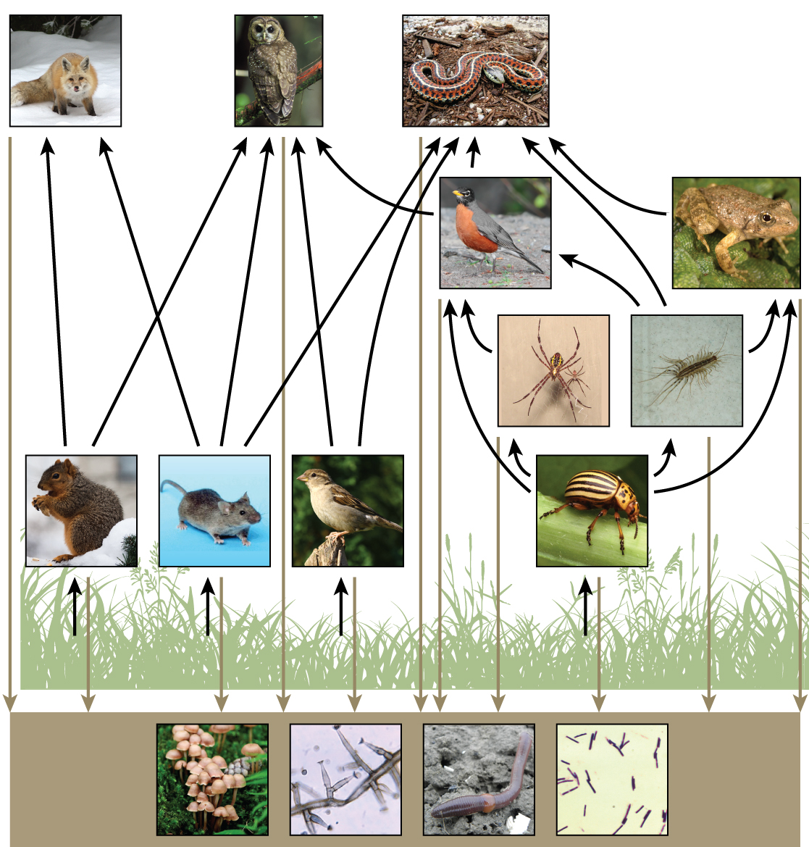
Energy, mass, and trophic levels
Grouping of species into trophic levels based on feeding relationships
Primary producers
Primary Consumers
Secondary (and Tertiary) Consumers
Decomposers

Slide 9
Ecosystems & Restoration Ecology

Slide 10
Learning Goals
Explain what primary production is and how it is measured
Identify and explain the factors that account for differences in primary production in different places
Explain why trophic efficiencies are low in ecosystems

Slide 11
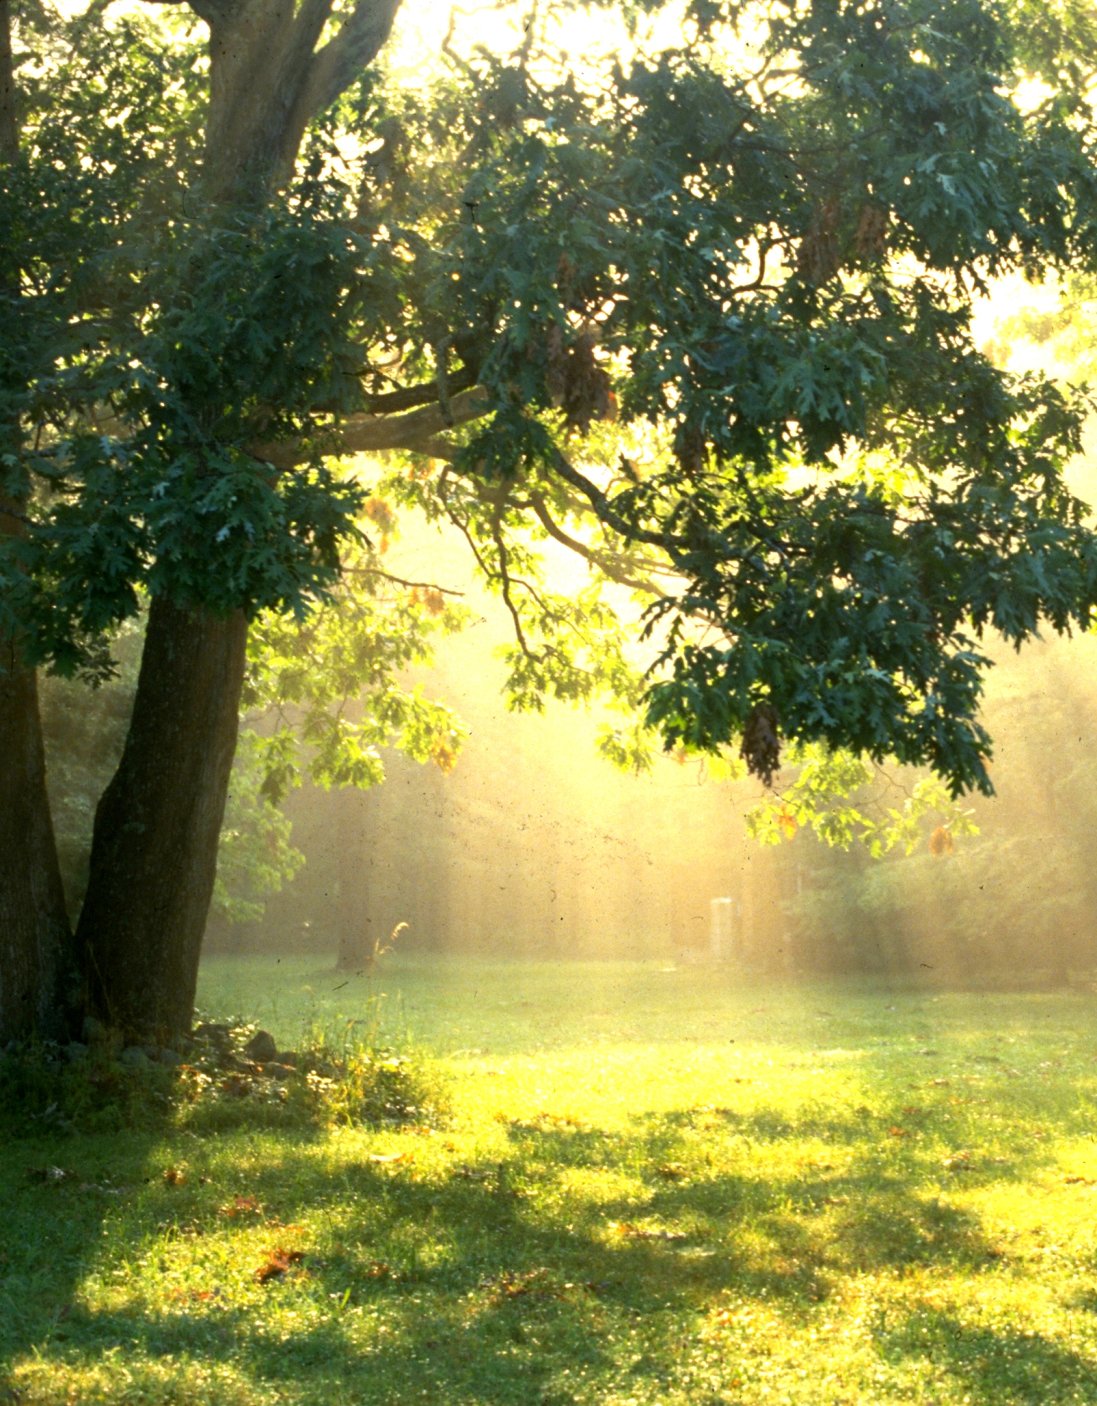
Primary production
Primary production - amount of light energy converted chemical energy by primary producers during a given period of time
Energy per unit area per unit time (J/m2/yr)
Biomass per unit area per unit time (g/m2/yr)

Slide 12
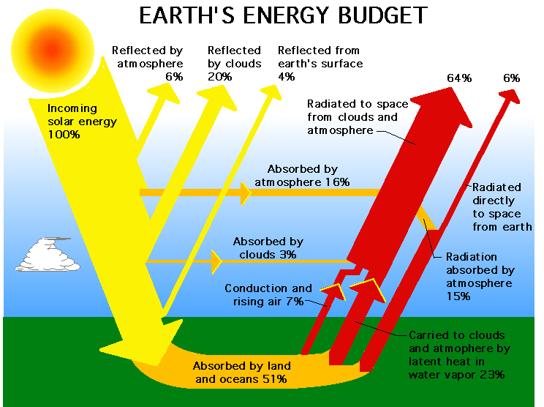
The sun provides nearly all of the energy used by ecosystems
Only 1% of visible light is used to drive photosynthesis
The primary producers use this light to make 150 billion metric tons of biomass per year

Slide 13
Gross and net primary production
Total primary production in an ecosystem = gross primary production, or GPP
Net primary production (NPP) is GPP minus the energy used by autotrophs for respiration
NPP = GPP - Ra

Slide 14
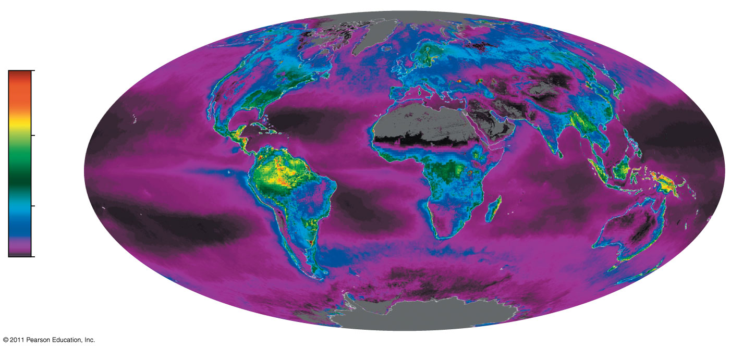
Figure 55.6
NPP varies globally
Net primary production (kg carbon/m^{2.}yr)
3
2
1
0
Notes:
Figure 55.6 Global net primary production.

Slide 15
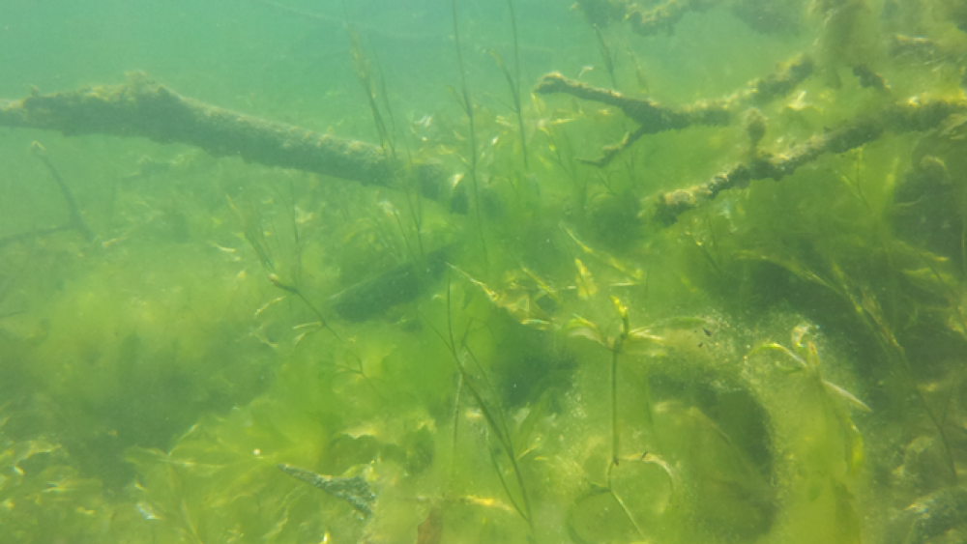
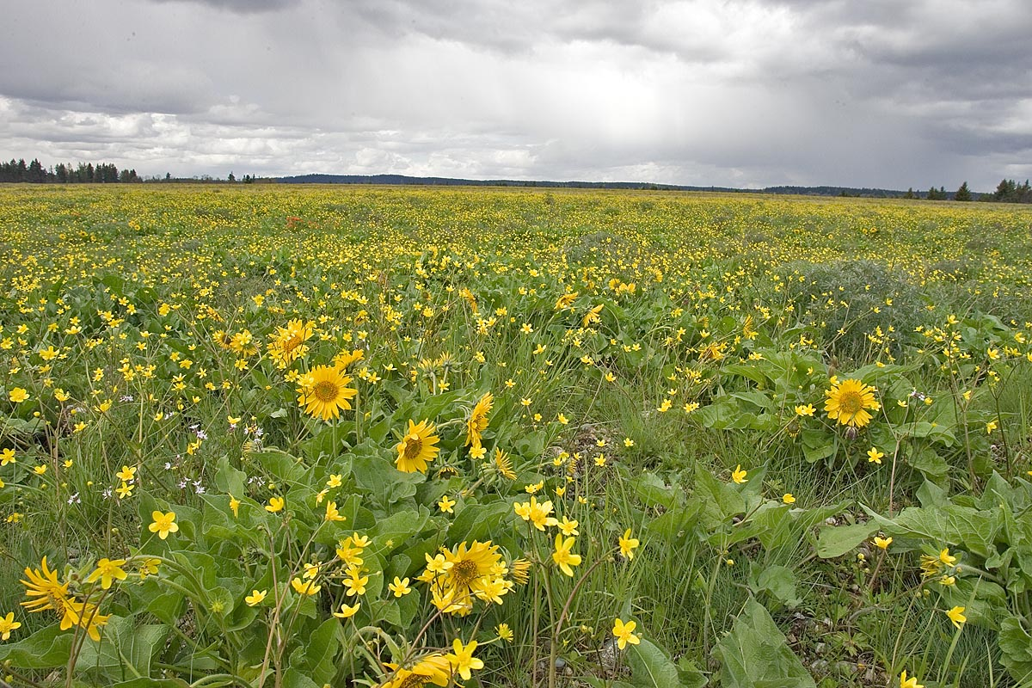
Why does NPP Vary?
Differences between aquatic and terrestrial ecosystems
Aquatic ecosystems - light limitation and nutrient limitation
Terrestrial ecosystems - temperature and precipitation

Slide 16
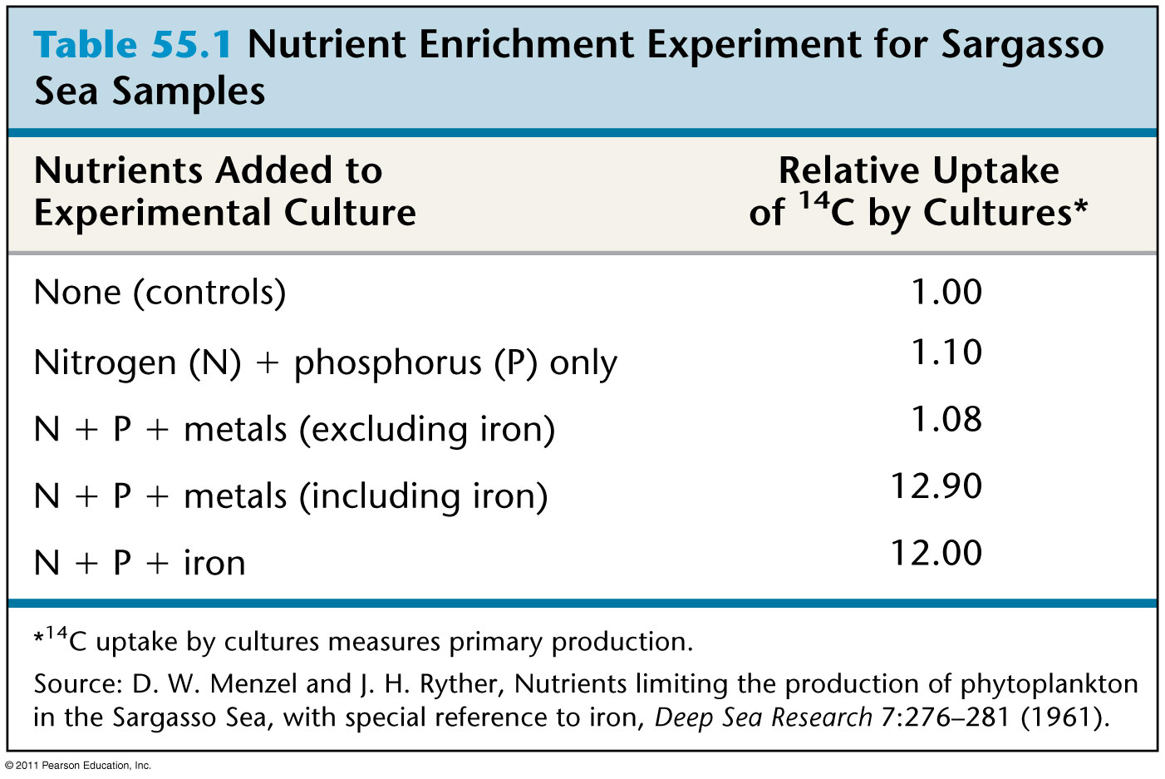
Table 55.1
Nutrient Limitation in the Sargasso sea
Notes:
Table 55.1 Nutrient Enrichment Experiment for Sargasso Sea Samples

Slide 17
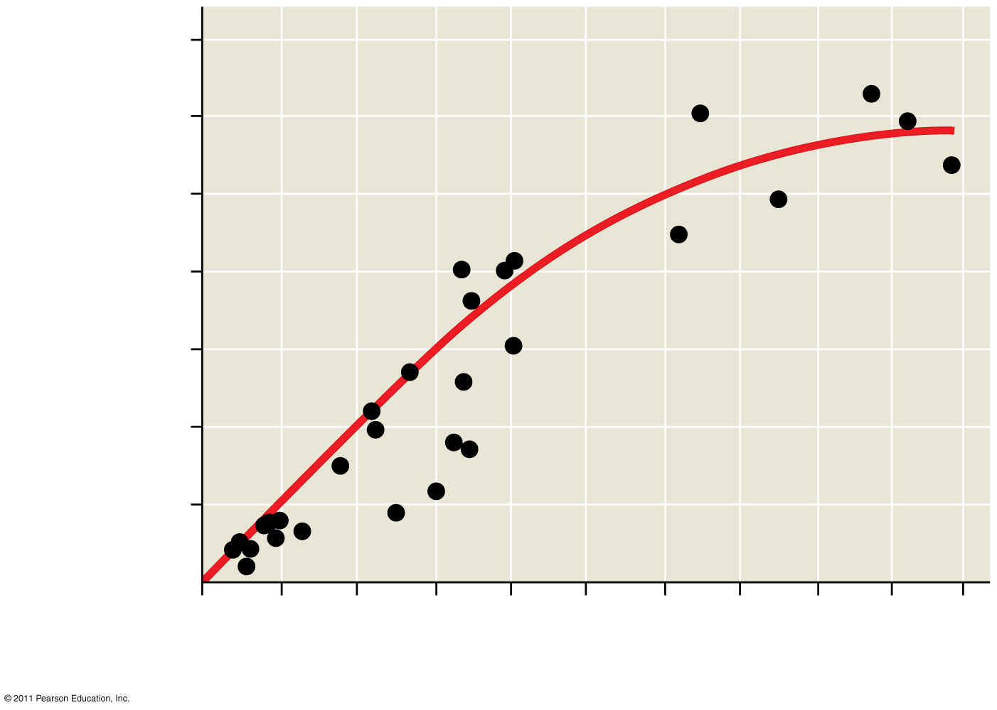
Figure 55.9
1,400
1,200
1,000
800
600
400
200
Net annual primary production (above ground, dry g/m^{2.} yr)
0
20
40
60
80
100
120
140
160
180
200
Mean annual precipitation (cm)
Notes:
Figure 55.9 A global relationship between net primary production and mean annual precipitation for terrestrial ecosystems.

Slide 18
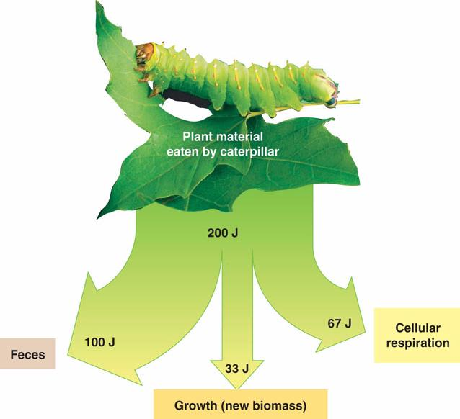
Energy transfers between trophic levels are only 10% efficient
Secondary production - amount of chemical energy eaten by primary consumers that is converted into biomass

Slide 19
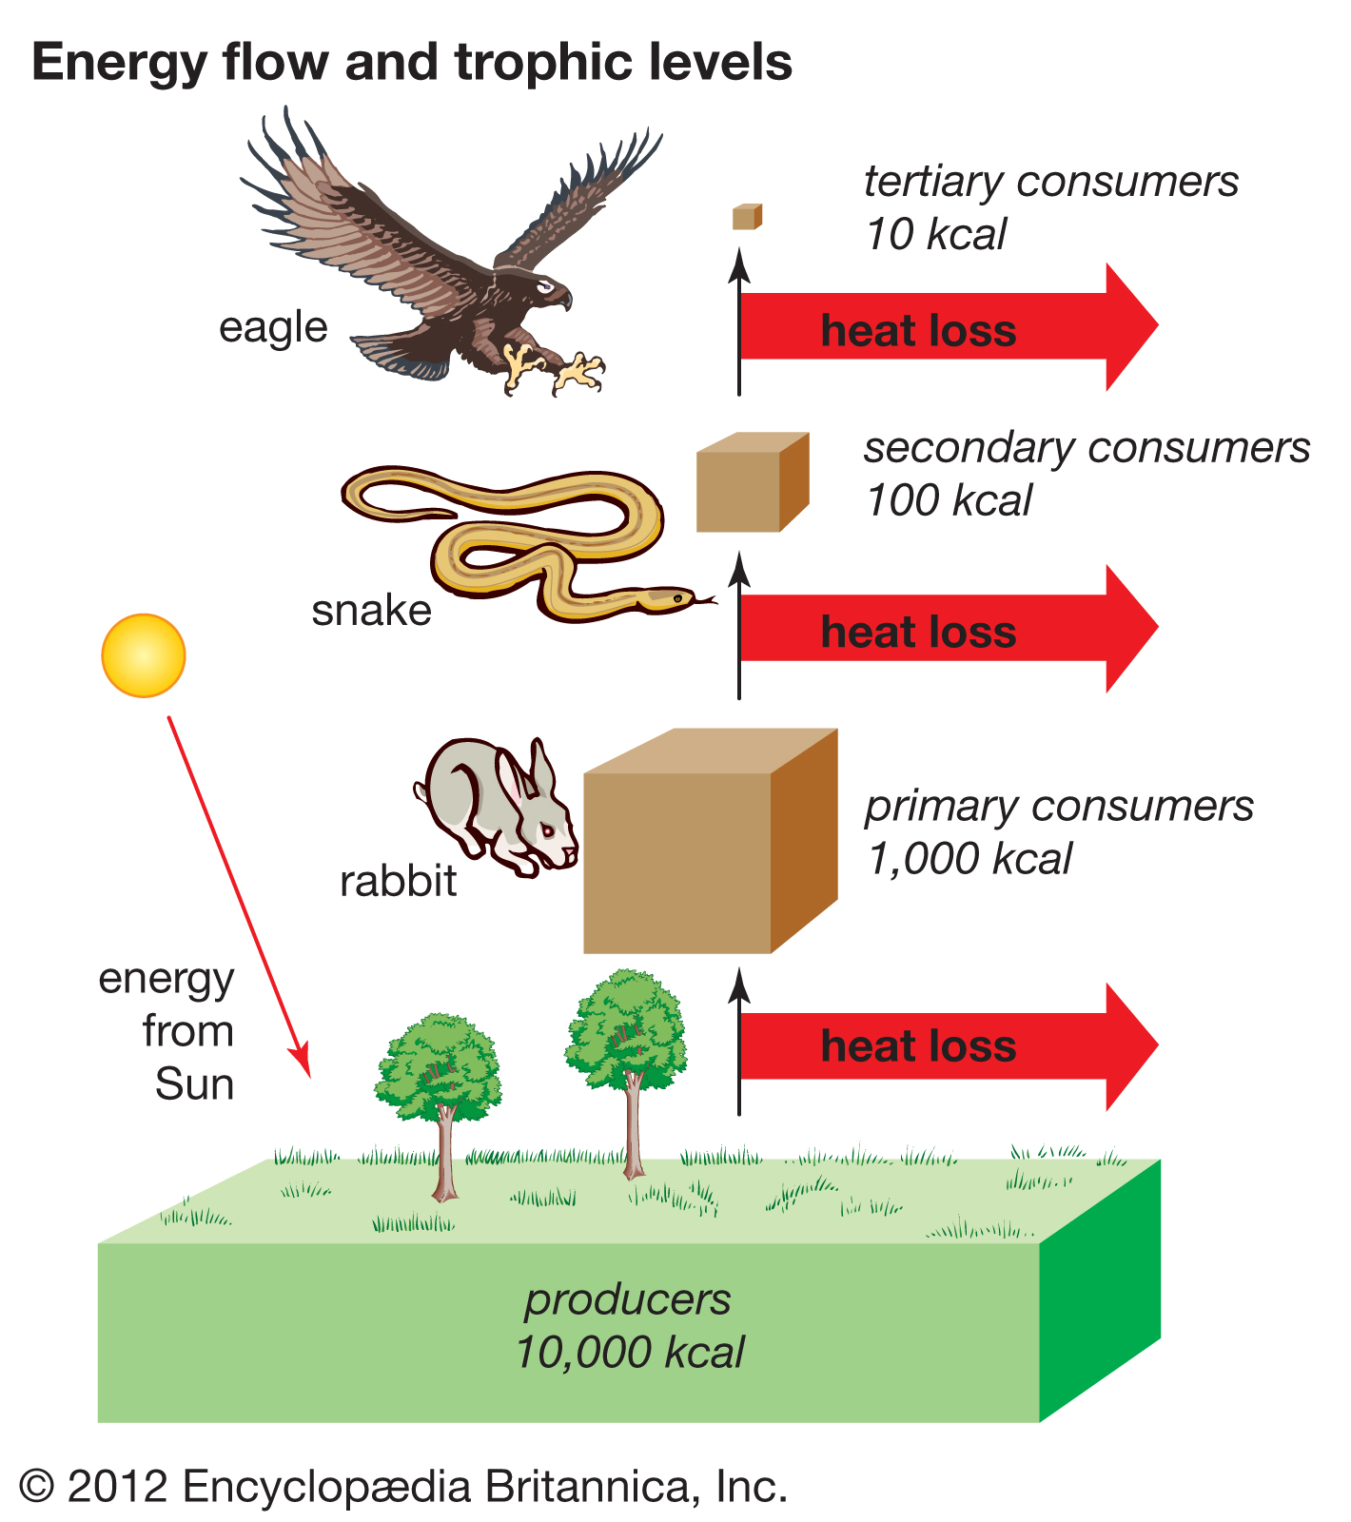
Trophic efficiency -
the percent production transferred
from one trophic level to the next

Slide 20
Ecosystems & Restoration Ecology

Slide 21
Learning Goals
Explain why elements cycle in ecosystems, and provide an example of a biogeochemical cycle

Slide 22
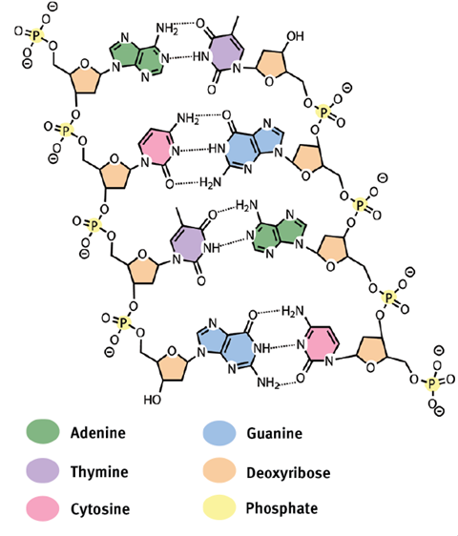
Biological and geochemical process cycle elements and water
Life depends on essential chemical elements, not just energy
These elements are constantly being replaced in bodies of organisms
Because of the law of the conservation of mass, these chemical elements are not used up

Slide 23
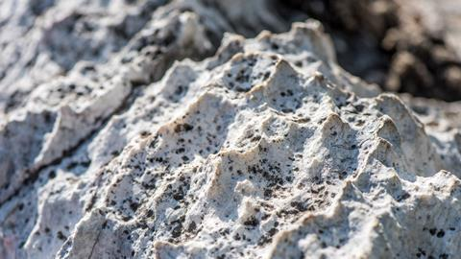
Biogeochemical cycles
Cycles involve both biotic and abiotic components
Carbon, calcium, etc.

Slide 24
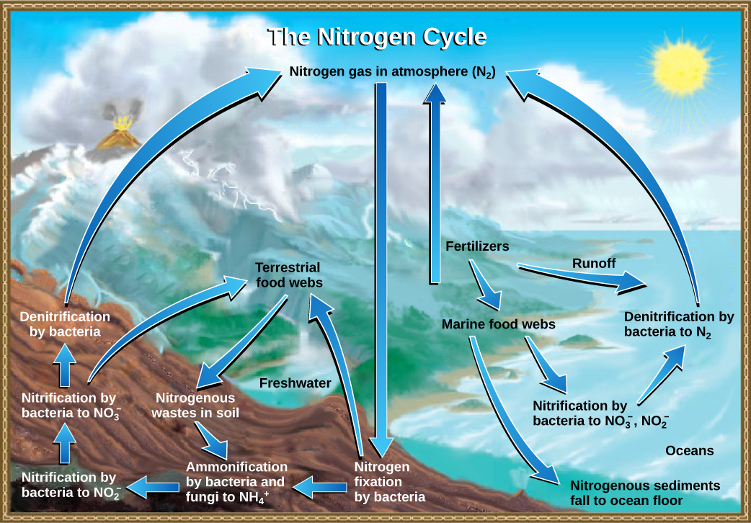
Examples of biogeochemical cycles
Carbon cycle
Nitrogen cycle
Phosphorus cycle

Slide 25
Ecosystems & Restoration Ecology

Slide 26
Learning Goals
Identify conditions under which ecosystem restoration might be used, and differentiate between bioremediation and biological augmentation

Slide 27
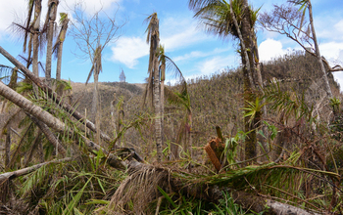
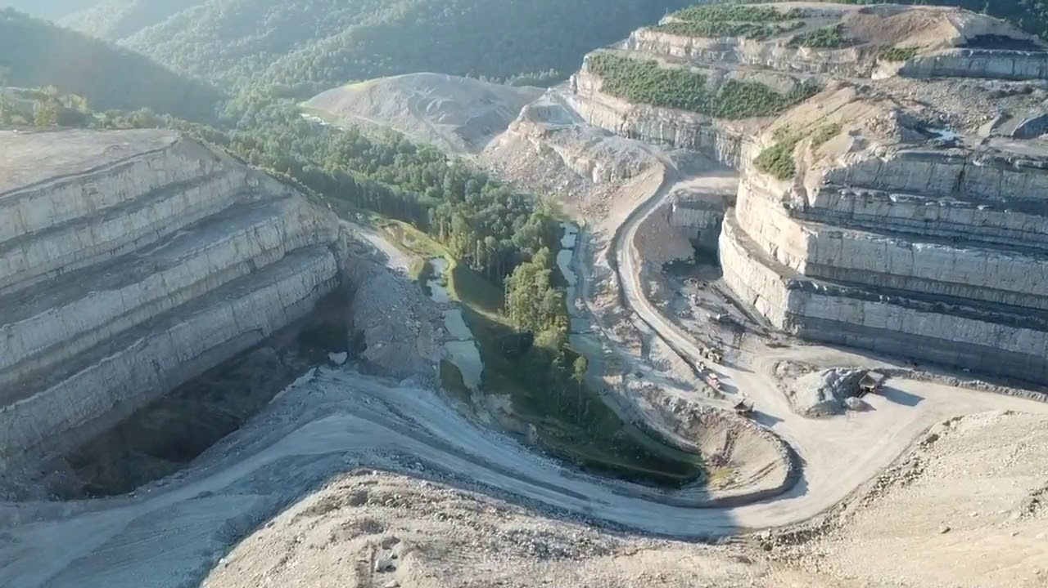
Ecosystems recover from disturbances, but sometimes the recovery can take centuries
Disturbance is part of ecosystems, they are able to recover from most disturbance events without intervention
Human degradation can slow the recovery: tropical deforestation, drylands grazing, surface mining, chemical spills

Slide 28
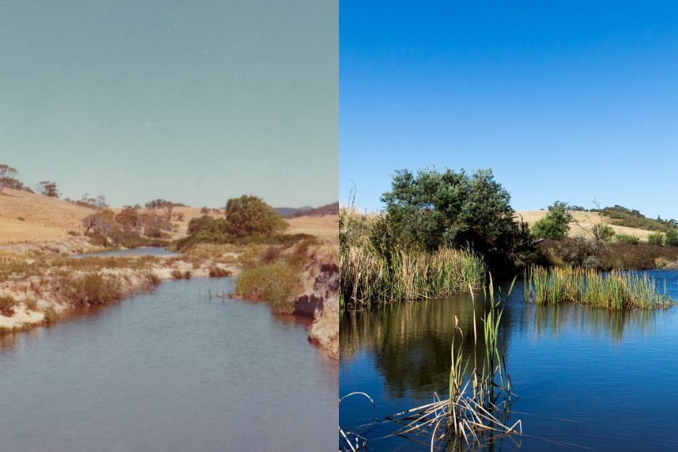
Ecosystem restoration
Ecological restoration - the practice of accelerating recovery of a degraded ecosystem
Bioremediation
Biological augmentation

Slide 29
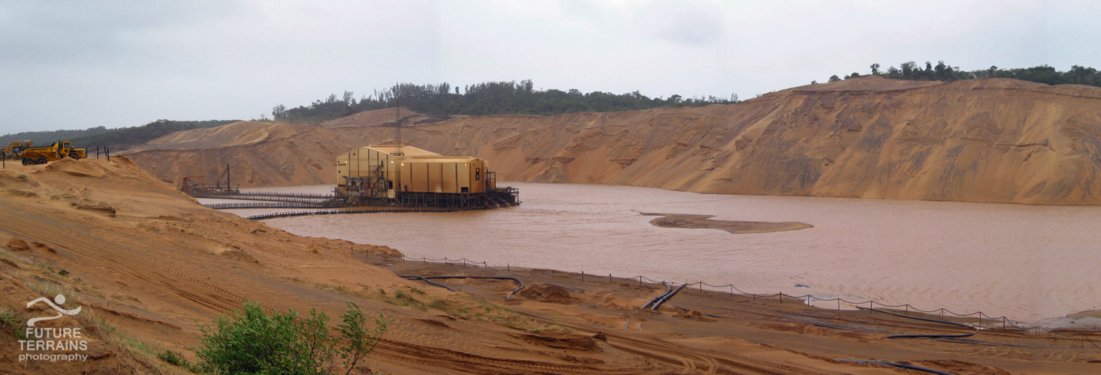
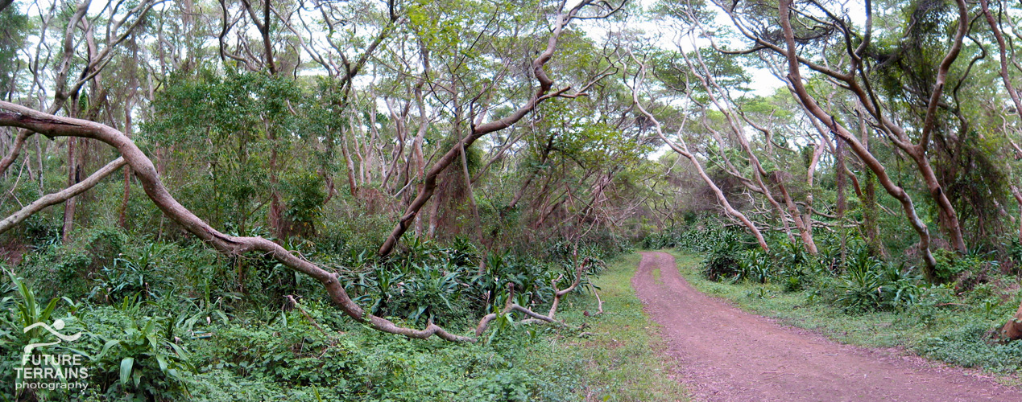

Slide 30
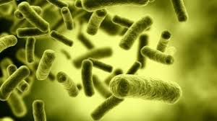
Bioremediation
The use of organisms to detoxify polluted ecosystems
Includes plants, fungi, prokaryotes
Methylocella silvestris - bacterium that biodegrades petroleum

Slide 31
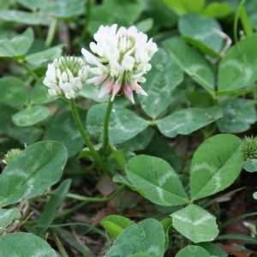
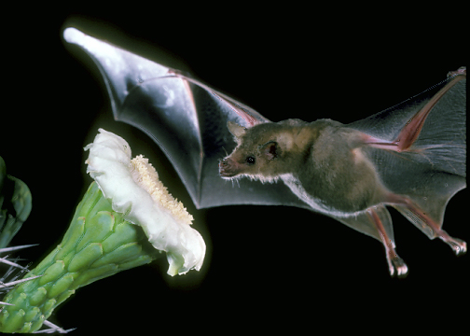
Biological augmentation
The addition of beneficial organisms to an ecosystem
Introduction of nitrogen fixing plants (clover), pollinators (like bats), predators, grazers

